Slide 1

Hello! We’re Team 7
K. Sai Anand Vardhan - 18501A0125
R. Swapna - 18501A0146
Poojith Tatineni - 18501A0144
K. Chandrasekhar - 18501A0123
L. Srinivasa Rao - 18501A0127

Slide 2
DESIGN AND ANALYSIS OF G+3 COMMERCIAL BUILDING

Slide 3
Intent
Draft the layout of the proposed commercial building using AutoCAD.
Design the structure using STAAD Pro V8i.
Analysis include footing, columns, beams, slabs, staircase.

Slide 4
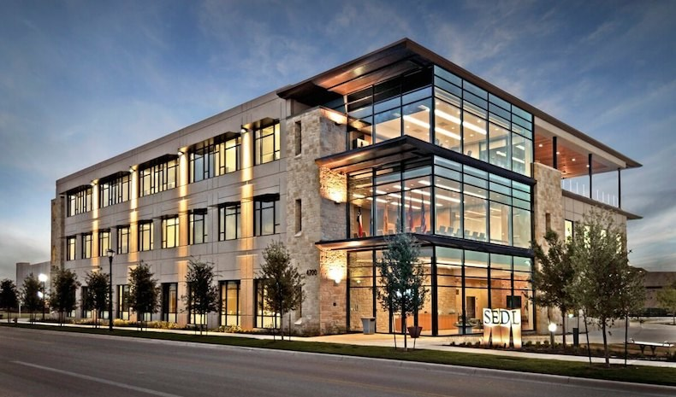

Slide 5

Structure Specifications

Slide 6
G+3 DATA
Type of Structure : Multi-Storeyed Rigid Jointed Frame
No. Storeys : 4 – G+3
Floor to Floor Height : 3.1m
External Walls : 230 mm
Internal Walls : 150 mm
Bearing Capacity of Soil : 200N/mm²

Slide 7
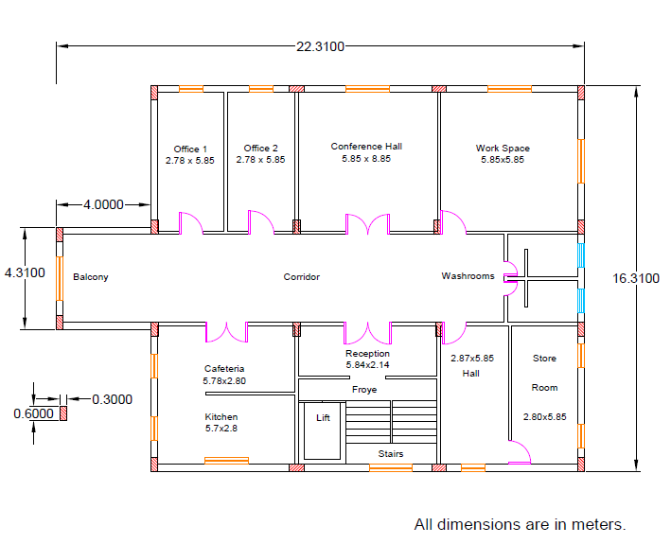
Plan

Slide 8
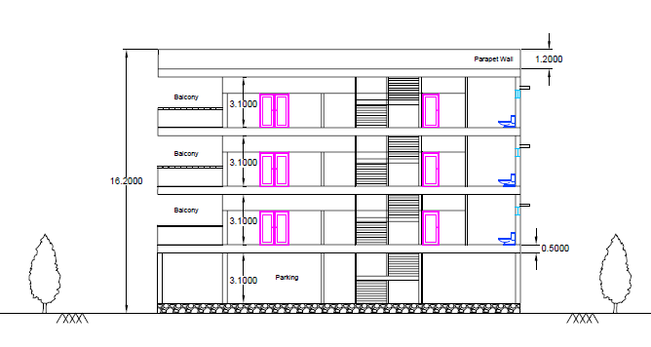
Elevation

Slide 9
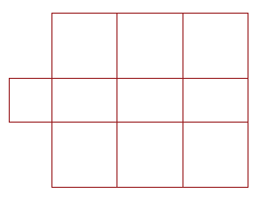
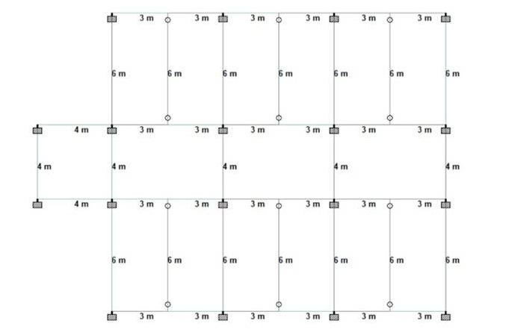
Centre Line Diagram

Slide 10
Total area of the building = 264.3 m²
Office 1 = 16.25 m²
Office 2 = 16.25 m²
Conference Hall = 34.21 m²
Work Space = 34.21 m²
Cafeteria = 16.1 m²
Kitchen = 17 m²
Hall = 16.8 m²
Store Room = 16.42 m²
Corridor = 54.74 m²
Reception = 12.52 m²
Washrooms = 10.16 m²
Balcony = 14.3 m²
Froye = 5.34 m²

Slide 11
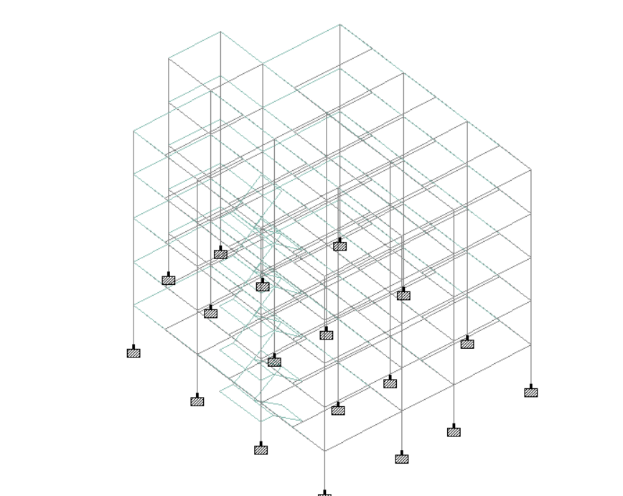
Skeletal Structure

Slide 12
Procedure to Create a Project in Staad
PLACING NODES
CONNECTING BEAMS
TRANSLATIONAL REPEAT
APPLYING LOADS
ASSIGNING PROPERTIES AND MATERIAL
ASSIGNING SUPPORTS
ANALYZING

Slide 13
Component Properties
Rectangular Section
Size of BEAM : 0.45m x 0.23m
Size of Column : 0.6m x 0.3m
Thickness of Slab : 0.18m
Material : Concrete

Slide 14
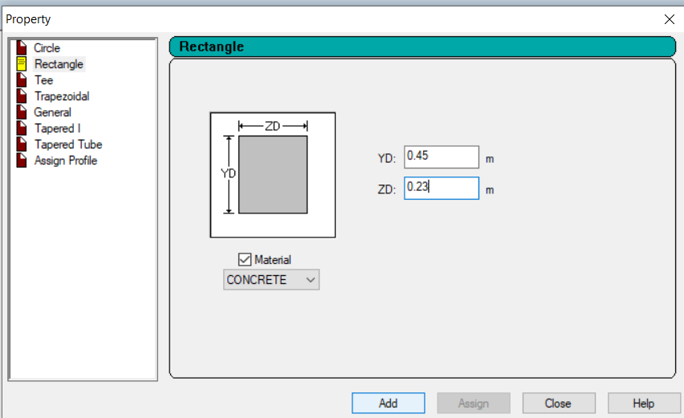
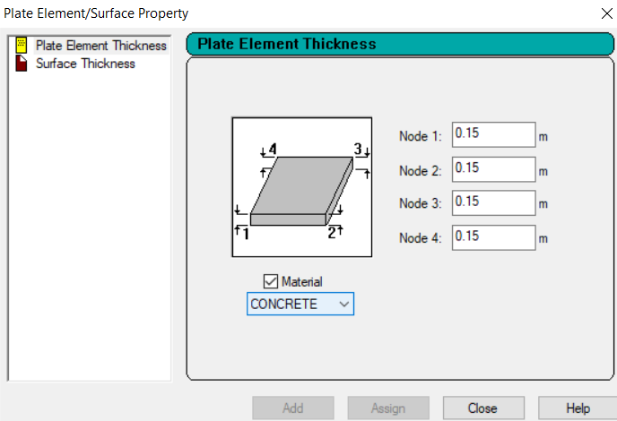
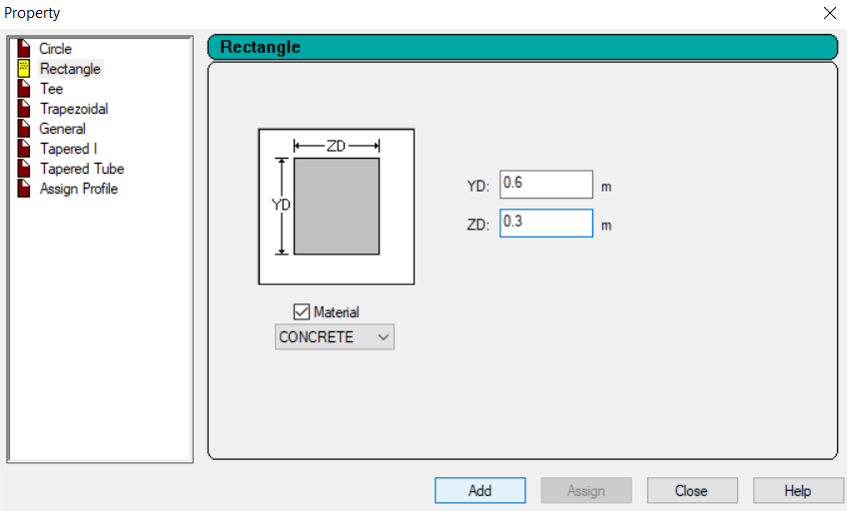

Slide 15
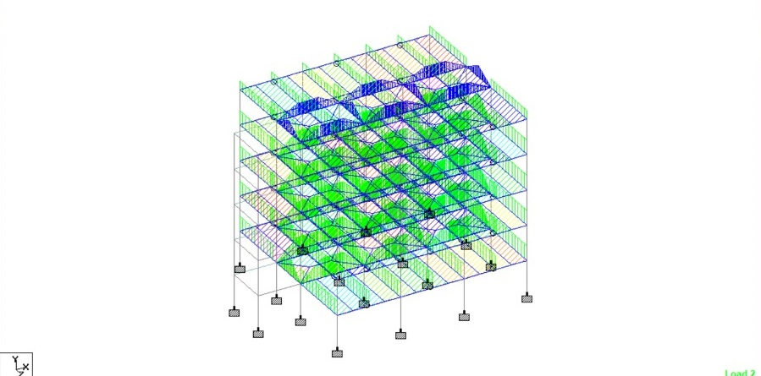
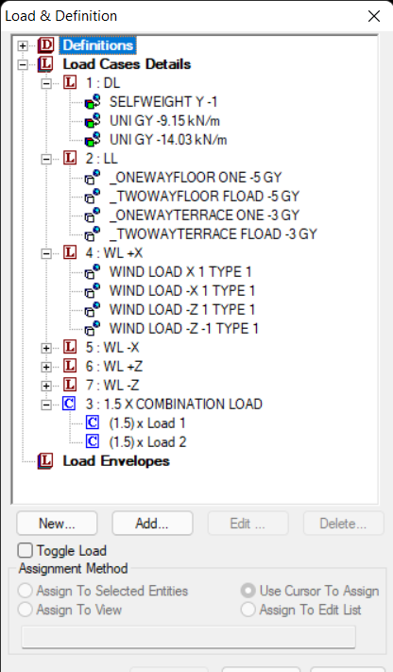
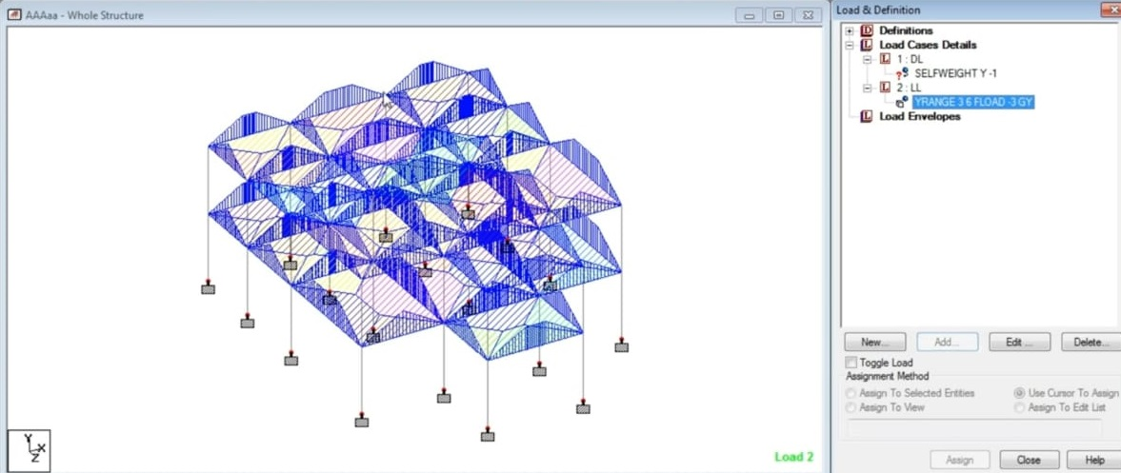
Loads

Slide 16
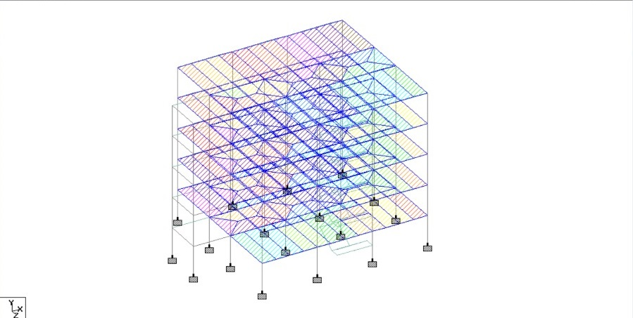
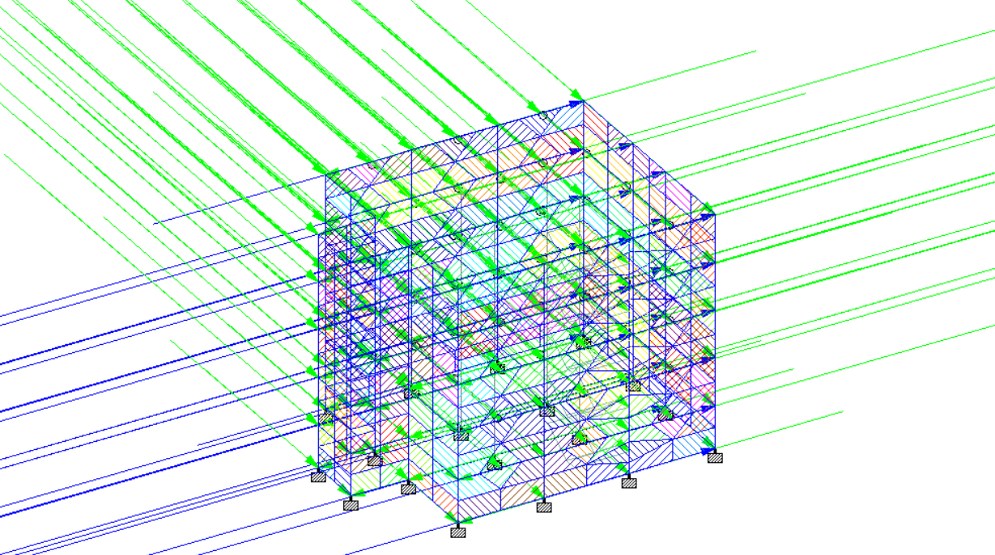

Slide 17

Asssigning Parameters
Parameters such as strength of concrete, yield strength, clear cover etc.
Assigned using codes IS456.
Concrete M20 Grade
Steel Reinforcement Fe415
Unit Weight of Concrete = 25 kN/m^3
Unit Weight of Masonry = 20 kN/m^3

Slide 18

POST PROCESSING

Slide 19
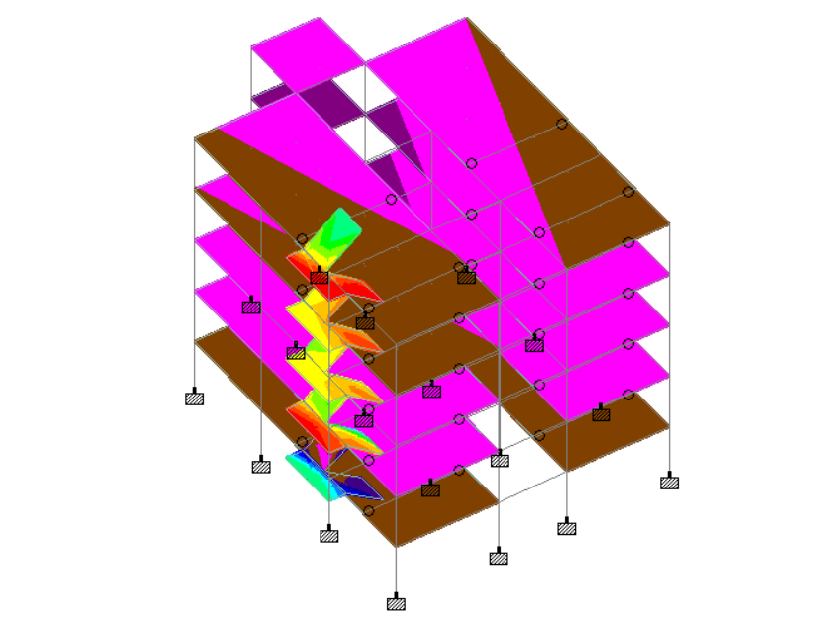
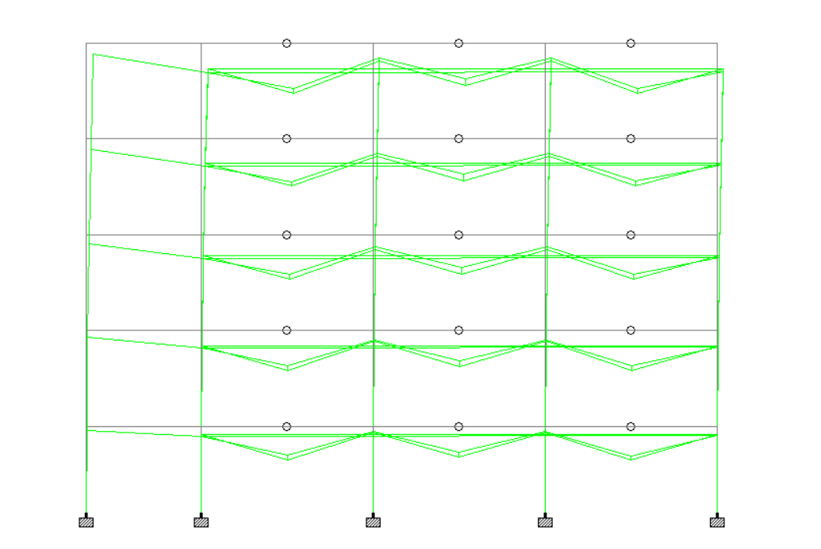
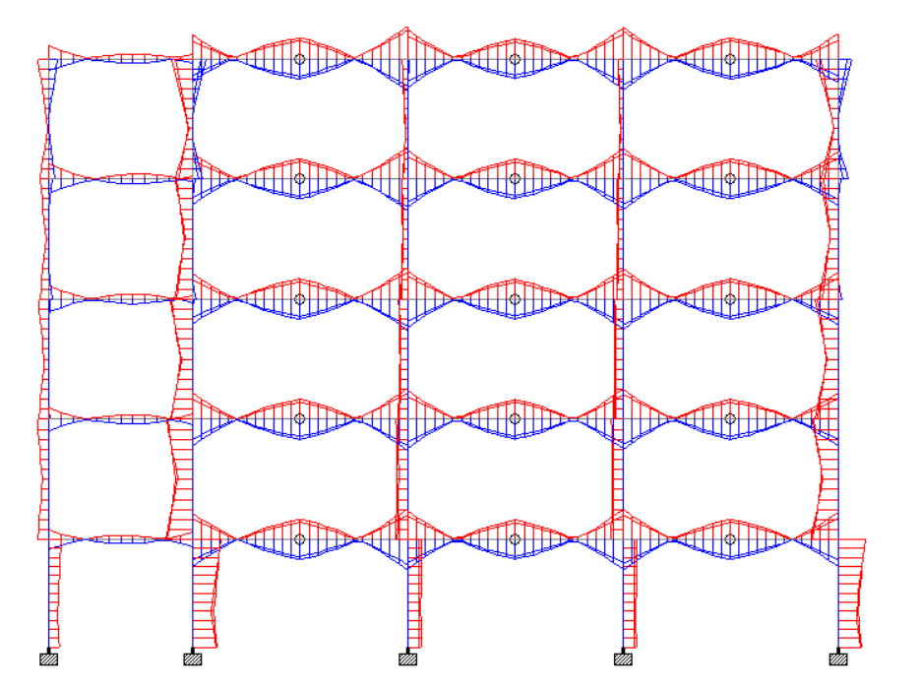
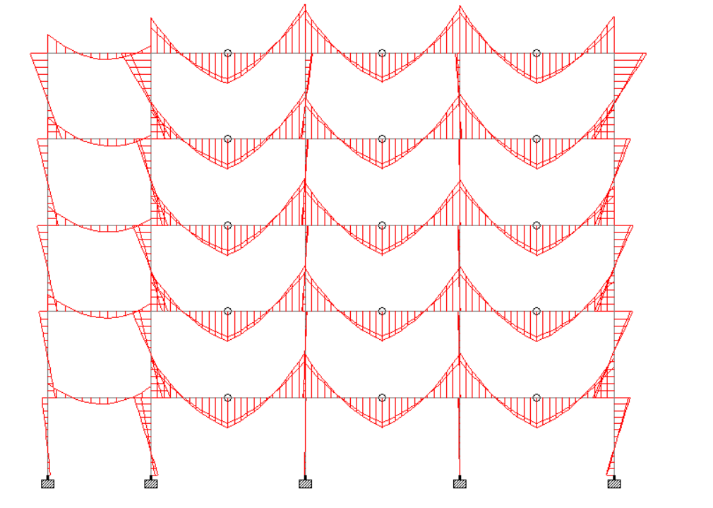
PLATE
STRESS
BEAM DISPLACEMENT
BMD
SFD

Slide 20
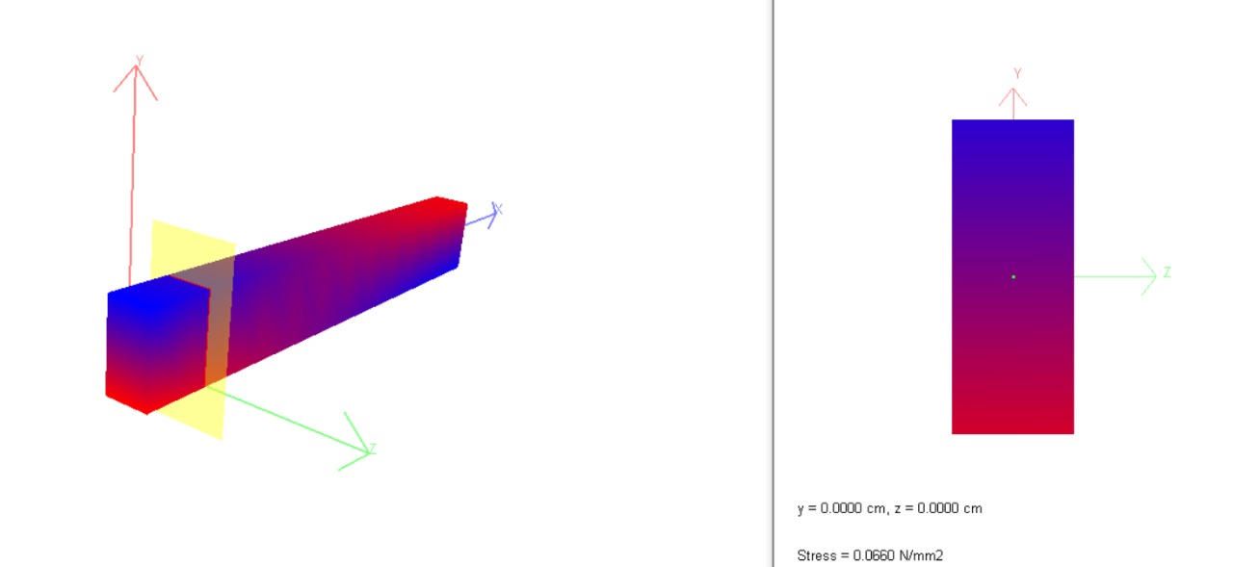
Stress Behaviour

Slide 21
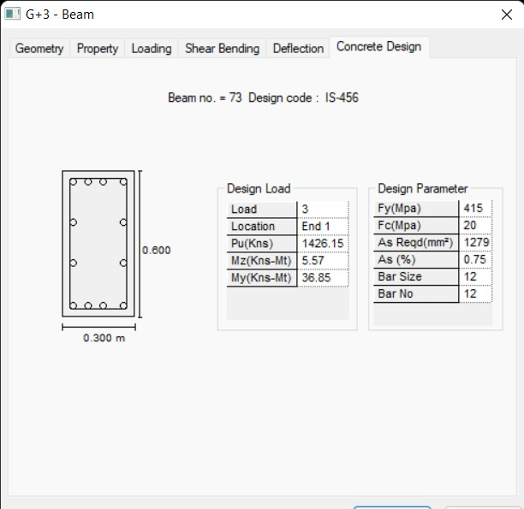
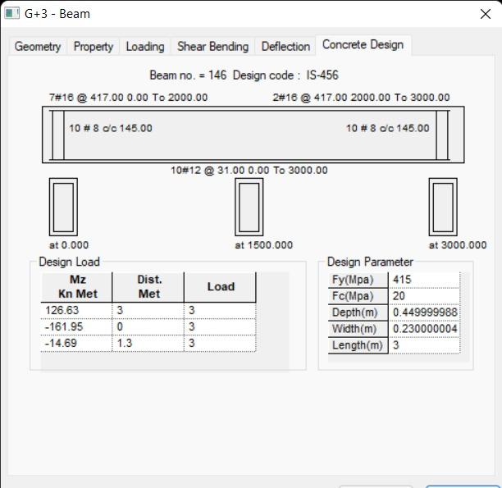
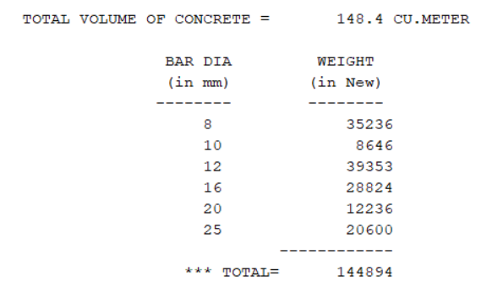
Components

Slide 22
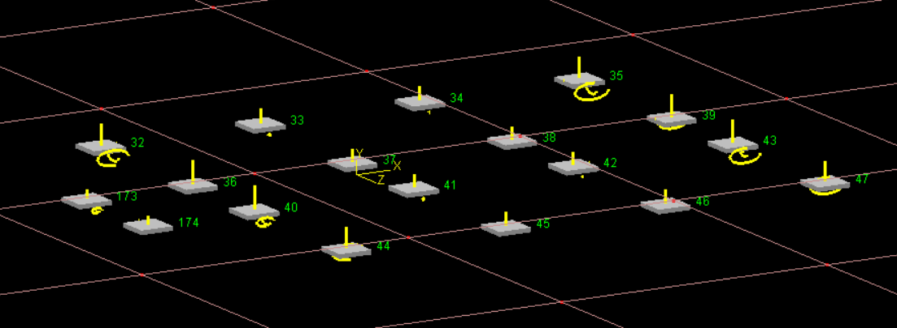
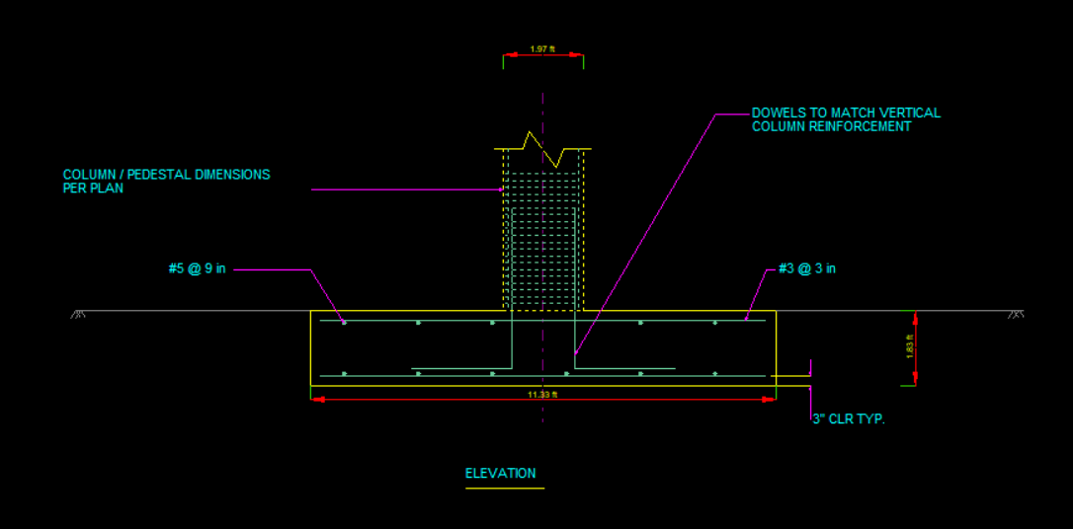
Foundation

Slide 23
ISOLATED FOOTING

Slide 24
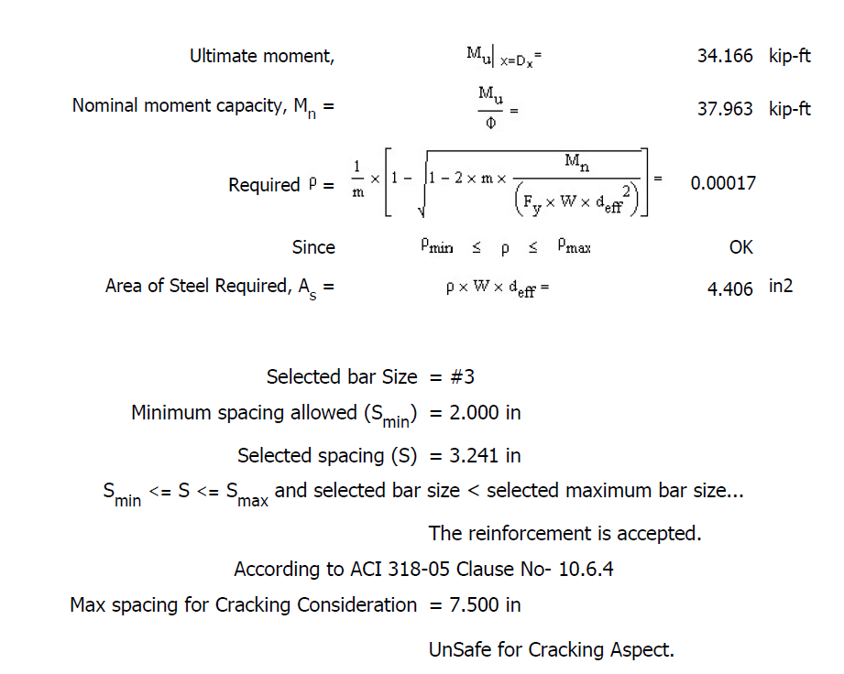
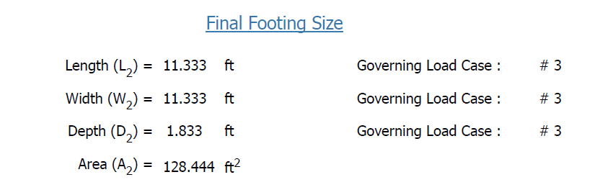

Slide 25
CONCLUSION

Slide 26

Planning, analysis and design of g+3 commercial building was done.
It's the g+3 building with parking in the basement.
The analysis and design were done according standard specifications using staadpro.
Deflection and shear tests are checked for beams, columns and slabs.
The tests proved to be safe.

Slide 27
Thank You!
Any questions?

